Slide 1


October 1st, 2024
1:00pm – 3:30pm
Oregon Conservation and Recreation Fund
Advisory Committee Meeting
Virtual Meeting

Slide 2
Agenda Item 1:
Review and Approve Meeting Minutes
(September 3rd, 2024)

Slide 3
Draft Motion Templates re: Minutes
I move to approve the September 3rd, 2024 meeting minutes with the continued authority to correct spelling, grammar, and punctuation.
I move to approve the September 3rd, 2024 meeting minutes with the addition/correction/ deletion of ____ on page ___, line ____, and continued authority to correct spelling, grammar, and punctuation.

Slide 4
Agenda Item 2:
OCRF Fall 2024 RFP Guidance

Slide 5
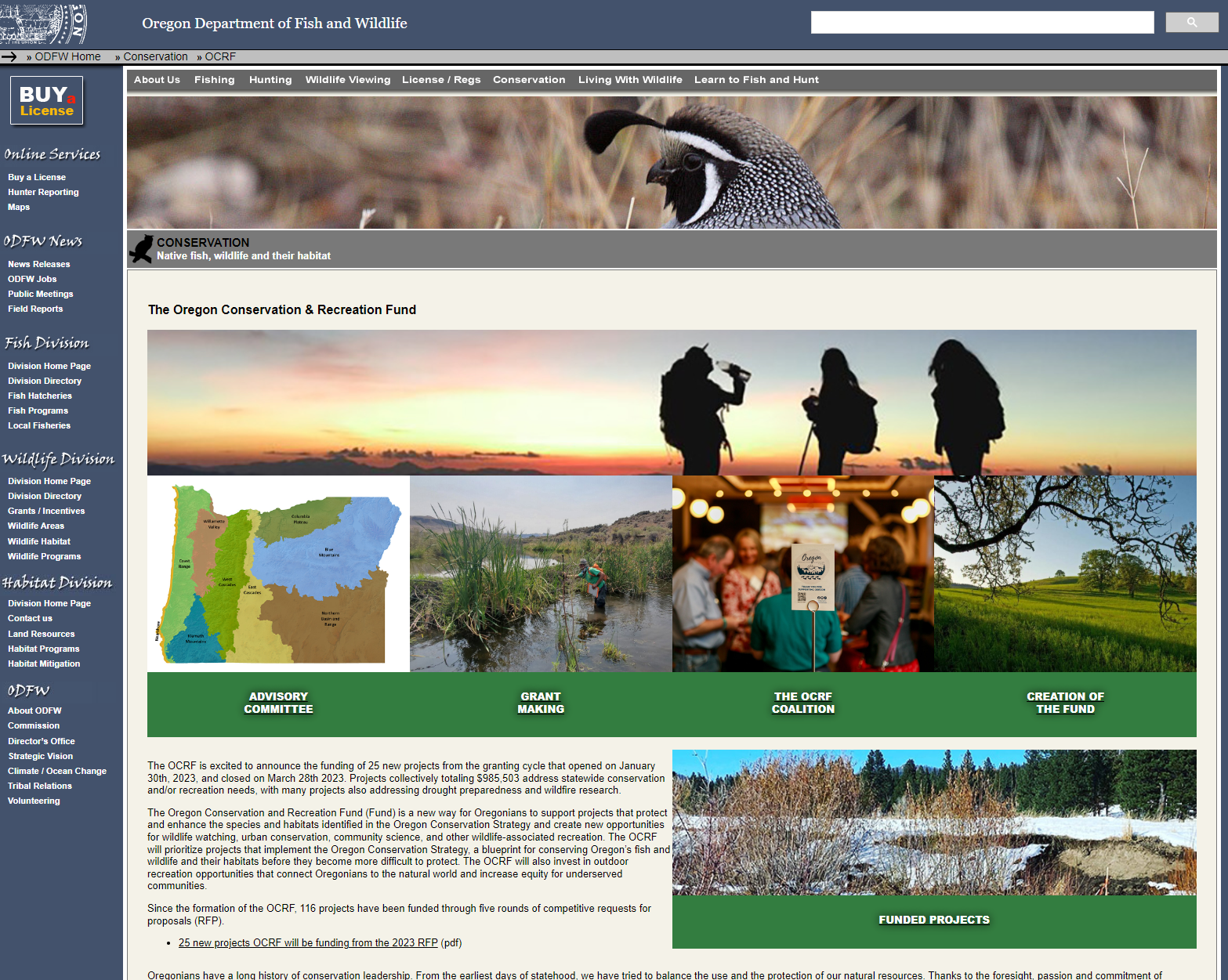
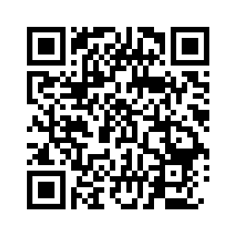

Now Open - Fall 2024 Call for Proposals
Notes:
Visit our website for more information

Slide 6
Fall 2024 Call for Proposals : Conservation and Outdoor Recreation Projects
Application period open : August 30, 2024 until October 29, 2024.
~ $800,000 will be granted to projects that address the impacts of drought on Oregon's fish, wildlife and their habitats.
~ $200,000 will be granted to non-drought projects that address conservation/ recreation OCRF Program Priorities.
cap on institutional/organizational indirect overhead rates at 20% of the requested project budget.
Applicants are strongly encouraged to read through our updated project insurance guidelines.

Slide 7
Now Open - Fall 2024 Call for Proposals
Current Grant Cycle
Twice per year: Jan/Mar , Sep/Nov
Project funding levels: $50K, (current cycle Drought projects </= $100K)
Now Open!
Project Timelines: 1 to 3 years
Looking to grant ~ $1 million
Notes:
The Oregon Conservation and Recreation Advisory Committee was created to advise the Oregon Fish and Wildlife Commission on expenditures from the Fund.

Slide 8
OCRF Fall 2024 RFP - Timeline
Request for Proposals (RFP) – Open August 30th, 2024
Official RFP Guidance made public (open for 60 days)
Request for Proposals (RFP) – Close October 29th, 2024
Technical Review Period – Nov 12th to Dec 17th, 2025
OCRF Advisory Committee Review Period – Dec 18th to Jan 15th, 2025
(Release in November – more lead time)
OCRF Advisory Committee Recommendations – Feb 4th, 2025 meeting
ODFW Commission Voting – March 14, 2025
Release of funds following contracting process – May 2025

Slide 9
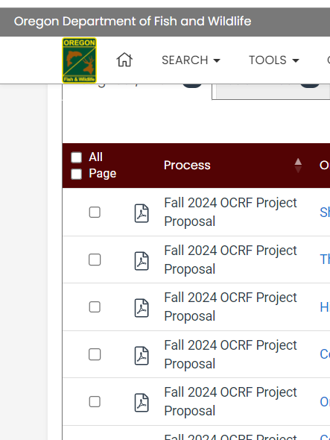
Fall 2024 Applications
Have been live for 1 month
9 draft applications in the grant system

Slide 10
Round Robin Discussion:
What aspects of project proposals have made them successful? (strengths that have stood out to you)
What aspects of proposals make them less successful? (Weaknesses that stood out to you)
What has stood out to you while reviewing, in general?

Slide 11
Agenda Item 3 :
Public Comment

Slide 12
Agenda Item 4:
Break
(Please be back in 5 min)

Slide 13
Agenda Item 5:
Boards and Commissions Overview
Brandy Hemsley, Executive Appointments Advisor, Governor’s Office

Slide 14
Agenda Item 6:
OCRF Project Presentation
Phil Simpson, ODFW : “Assessment of White Sturgeon Recruitment in John Day Reservoir”

Slide 15
Agenda Item 7:
OCRF Communications Strategy Update

Slide 16
OCRF Program Updates
OCRF Communications Strategy
OCRF Communications Strategy
OCRF Chairs, ODFW staff, and OWF developed a Communications Planning - Scope of Work
RFP was released by Oregon Wildlife Foundation (Tim Greseth)
RFP closed on July 24th. 11 proposals received
Review / Selection process almost complete
Communications review team has selected a final candidate. OWF is in the process of negotiating the Scope of Work and Contract.
Notes:
Conducted outreach, and OCRF representation at the Oregon outdoor recreation programs, trail alliances, Diversifying the pool of applicants that apply to OCRF. Hopefully this helps address the

Slide 17
Agenda Item 8:
Meeting Wrap Up and Next Steps

Slide 18
OCRF Budget Update – July ‘24
Base Program: $801,704
Calculated using (21-23 ending fund balance) + (23-25 revenue to date) – (allocated to projects)
Does not include future ELS donations for the remainder of 23-25, or interest that will be deposited in August
Drought Package: $1,607,609
(Remaining funds) – (Current Committed Projects + Personnel costs)
ARPA: $0
All Federal ARPA funds have been committed to projects
Personnel Costs | 80,000
Current Committed Projects | 2,920,034
Other (held by Oregon Wildlife Foundation): Oregon is Alive ~ $30,000

Slide 19
Conservation projects - Advisory Committee prioritizes:
• Habitat restoration
- improving habitat connectivity
o High priority: actions within Conservation Opportunity Areas
• Science, research, & monitoring related to the OCS,
community science activities.
o Highest priority: projects that benefit ODFW’s Wildlife Priority Strategy
Species
Notes:
Science, research, and monitoring directly related to implementing the recommendations in the Oregon Conservation Strategy, especially through community science activities.

